Slide 1
DEVELOP AN OUTCOME L2
Evidence of Learning Template
Orienteering Map Database
Callum Wishart

Slide 2
https://drive.google.com/drive/folders/1WItffflfjRA7crz987g85FzrYOlJiY6O?usp=sharing
Google Drive link
Monday.com link
https://view.monday.com/1407266127-8ca6800634055b92078c7d22af2b248d?r=use1

Slide 3
Project Management: Setup

Slide 4
Project Proposal
To first start planning what I wanted my program to do I created a very simple project proposal.
https://docs.google.com/document/d/1cL_rsTuTyQNQnko8cxE1-u9vgW3N_ntEQEedTbIk534/edit?usp=sharing

Slide 5
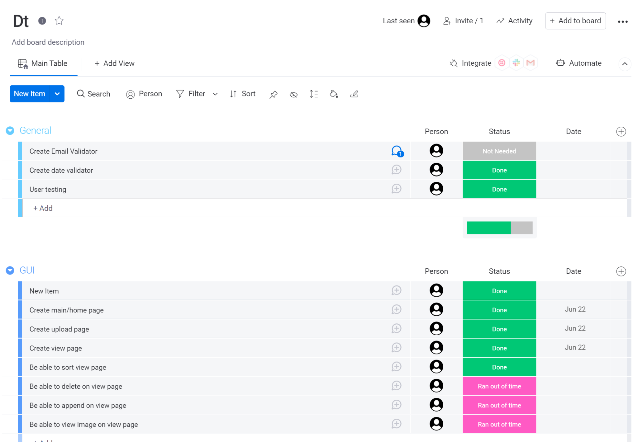
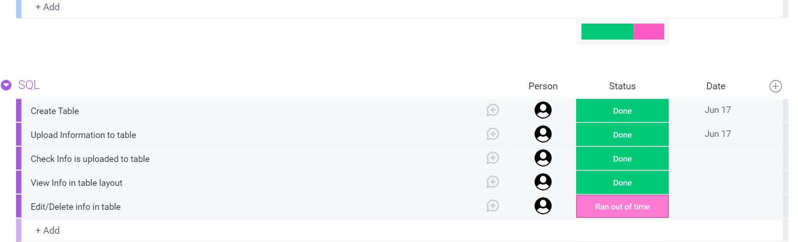
Record evidence that you have setup project management tools to manage the development of your outcome.
I used monday.com as my project management tool. Monday.com is a paid user experience however, there is a free trial that allowed me to use it. I wanted to use monday.com as it was easy to understand, set up tasks to do and group them into subcategories as well as allowing me to easily view what I should do next or what had been done.
If my free trial of monday.com ran out then I knew that I could easily switch to trello and not lose my project however I completed my project before my free trial ran out and monday.com allows you to refresh your trial each time it runs out.

Slide 6
Record evidence that you have chosen project management techniques to manage the development of your outcome.
One of the project management techniques I used was breaking down my workflow into subcategories, this allowed me to focus on what needed done and how long it would take and prioritise what was most important. An example of this was breaking down my project into GUI, database and general. I then further broke these categories into smaller, manageable tasks such as ‘create table’, ‘upload data to table’ and ‘query data’. This is shown visually on the next slide.
We were given 8 weeks to complete this task and monday.com helped me to organise my time by helping me achieve milestones and allocating a chunk of time to each task. This helped me to prioritise certain tasks for the set deadline.
Monday.com also allowed me to share tasks which helped me to get feedback from other users.
Another project management technique that I used was having backups of my project incase a file got deleted, this allowed me to minimise my time loss incase something went wrong so I would not have to start from scratch.

Slide 7
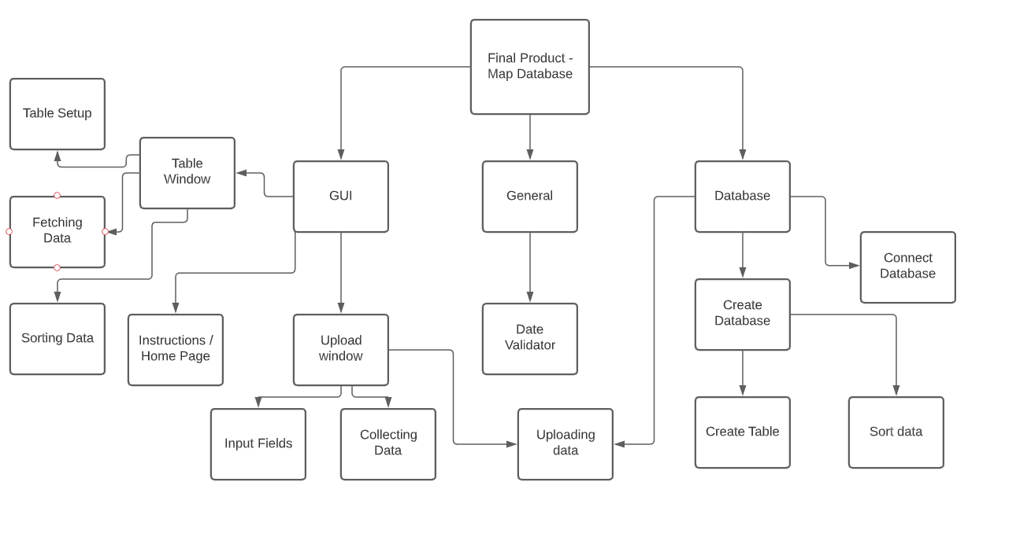
Mind Map

Slide 8
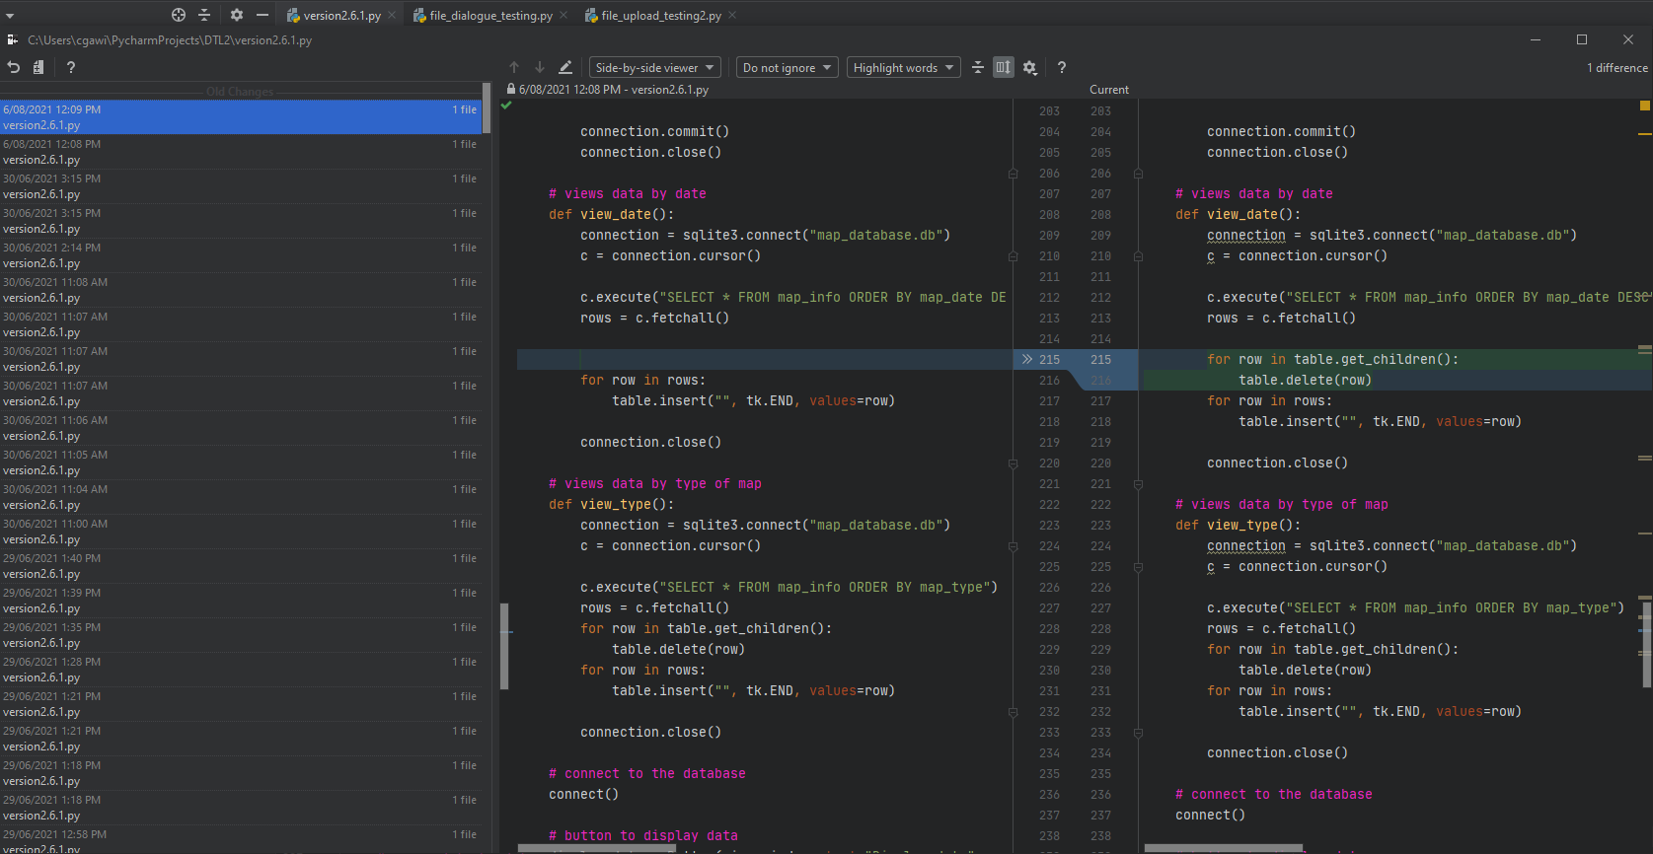
Record evidence that you have setup/ chosen version control tools/techniques to manage the development of your outcome.
I used Pycharm to develop my project, pycharm has an inbuilt feature which saves previous versions of my code. I used this feature in conjunction with saving versions to save over 20 testing / older versions of my code. This allowed me to keep previous code incase newer versions had faults allowing me to revert back to previous versions.
To manage this I had one file that I worked on and made copies of it everyday that there was major changes, I also saved copies when there was an error that I had to fix. Another way I managed version control was working on components in there separate files with their own version control and only implemented it in my main code when it was ready
Version control also helped me save backups of my project incase something went wrong or one of the files got corrupted.
Top: Screenshot showing local history window in PyCharm and how it highlights changes made and also when the changes were made.
Bottom: This was my main file that I worked on so it goes back to 19/05/2021 4:20 when it was still names something else.

Slide 9
Explain why you believe that these tools and techniques are appropriate for the development of your outcome.
The reason that I used monday.com is because I found it extremely easy to use and the graphical interface allowed me to easily understand what needed to be done and what had already been done. I chose monday.com over trello because from my first interactions with trello I found it harder to set up / use and prioritise my tasks, and although monday.com is more for teams and trello is more for one user I still found monday.com more suitable for my project.
I chose to use pycharm to develop my project because it specialises in python projects and is well set up for understanding conventions such as PEP8 and saving previous versions of my code.

Slide 10
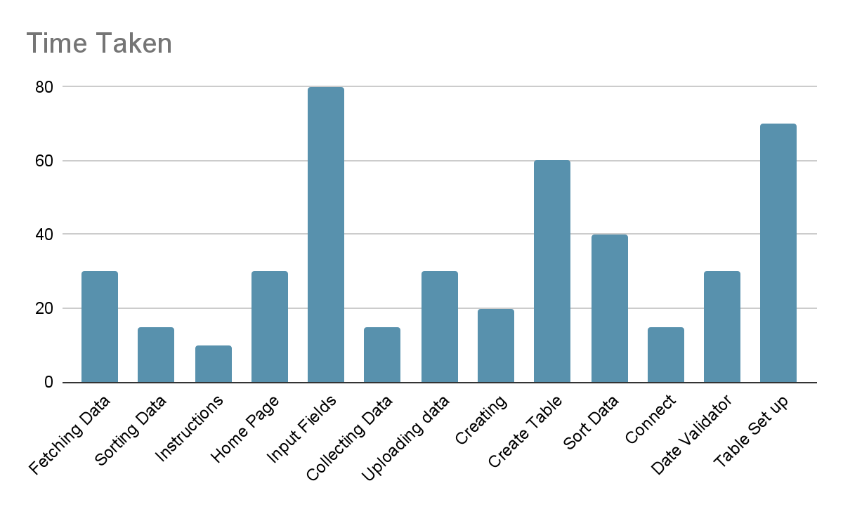
Decomposing outcome
To decompose my outcome I used monday.com to visualise this different components of my project and I set up 3 different categories with smaller tasks inside them.
I also decomposed the outcome by using functions so that different components could be worked on separately and called multiple times

Slide 11
Trialling components
Record evidence that you have trialled components. Show that you gathered information to inform your decision making.
Record evidence that you have trialled multiple components and have selected those most suitable.
Record evidence that you have used information from trialling appropriately to improve the functionality of the outcome.

Slide 12
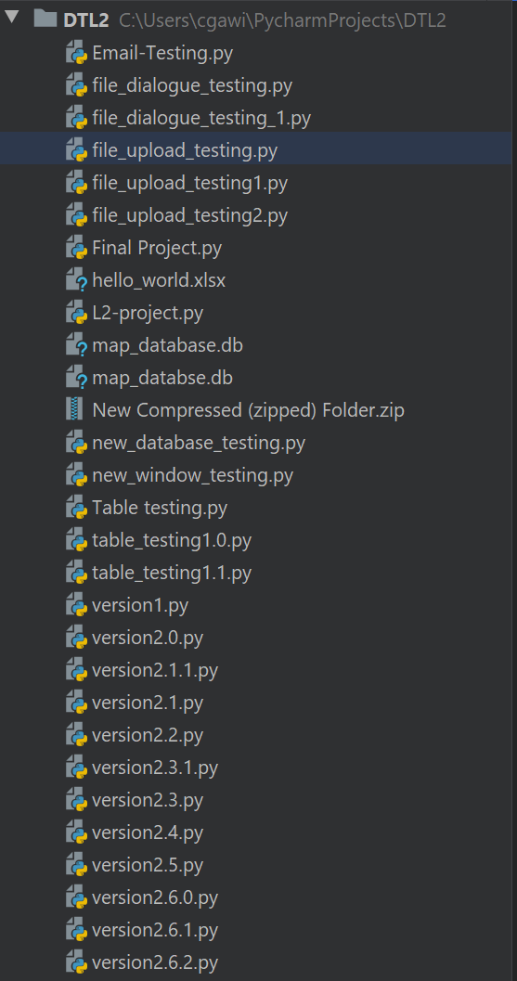
Record evidence that you have trialled components. Show that you gathered information to inform your decision making
I broke my project into different parts, the first lot of these parts which I trialled was ‘File Dialogue box’, ‘File Upload Window’, ‘New window’, ‘Database’, ‘Table Viewing’ as well as versions from 1.0 through to 2.6.1 showing various updates.

Slide 13
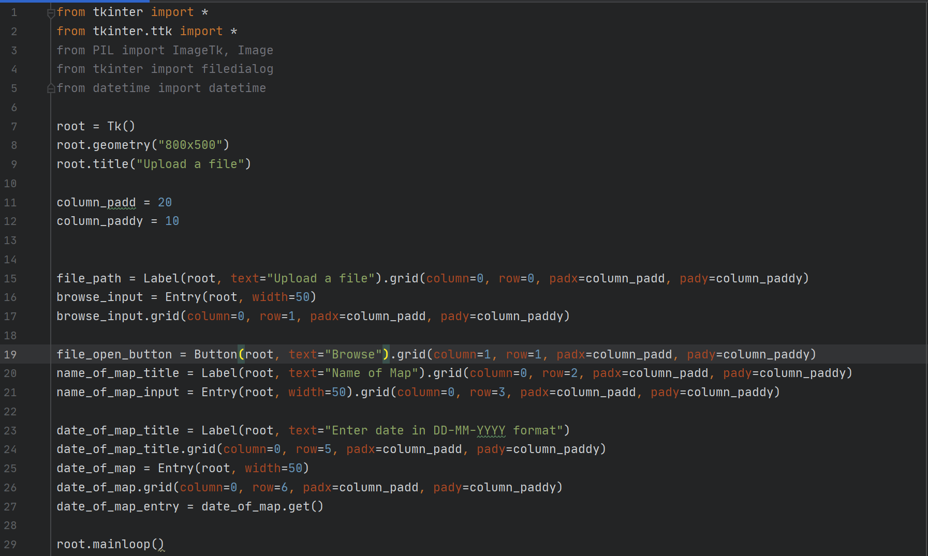
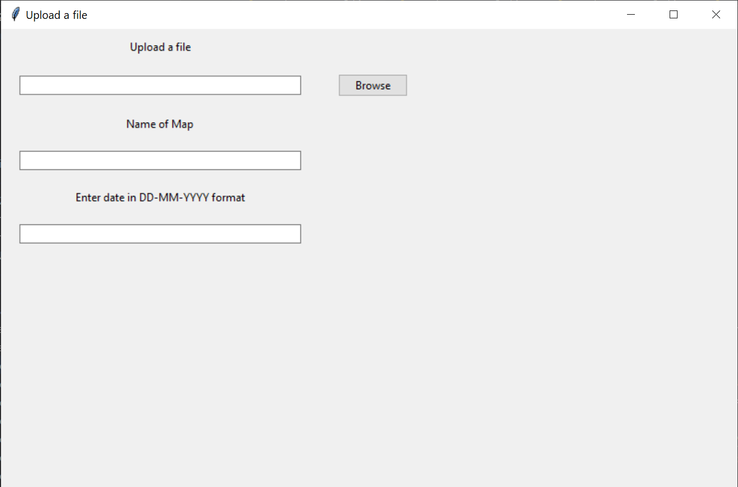
Record evidence that you have trialled multiple components and have selected those most suitable.
1
The first component that I trialled was my file upload window. It was very basic and had a few entry widgets as well as an non functioning button to browse files.

Slide 14
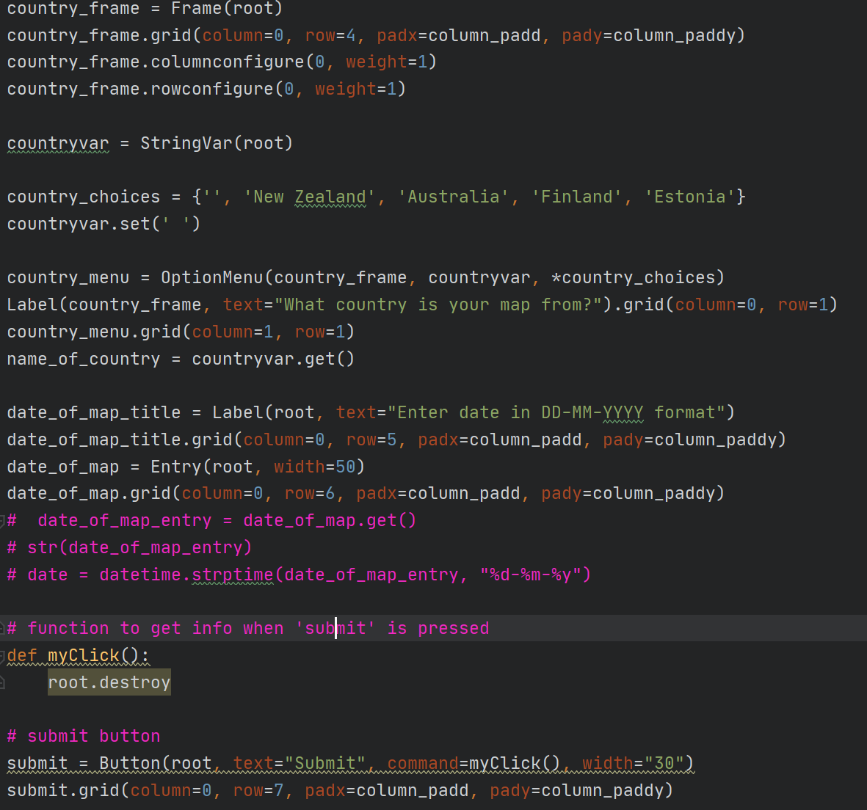
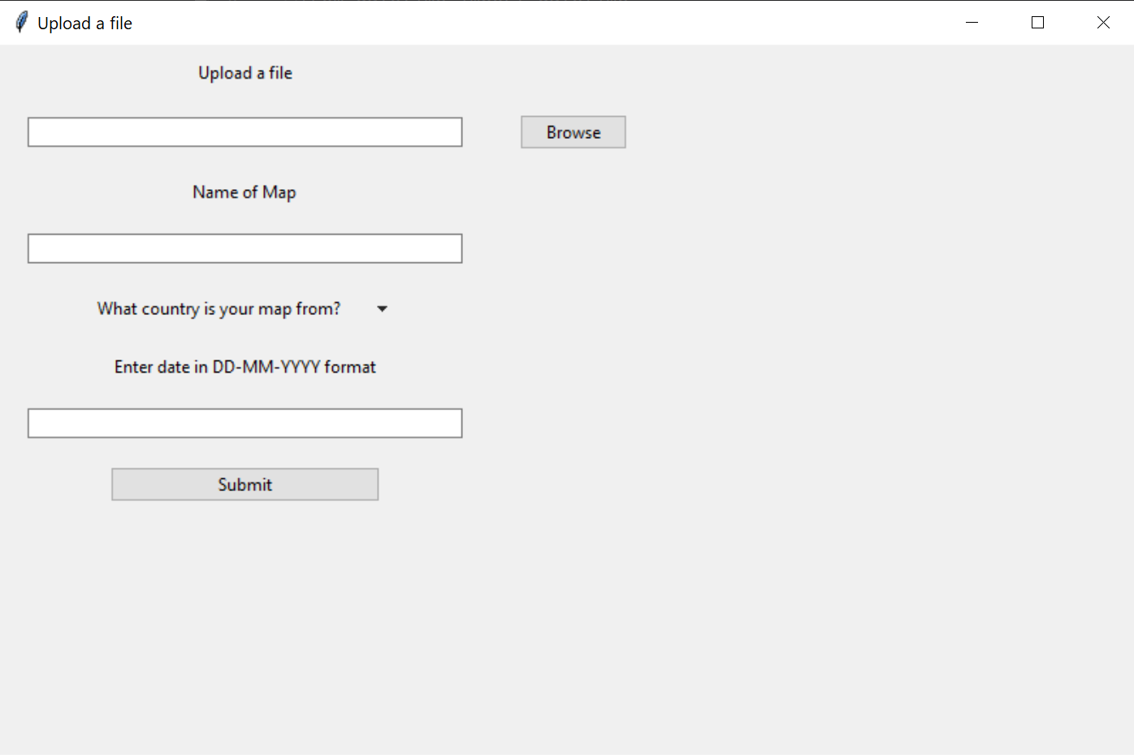
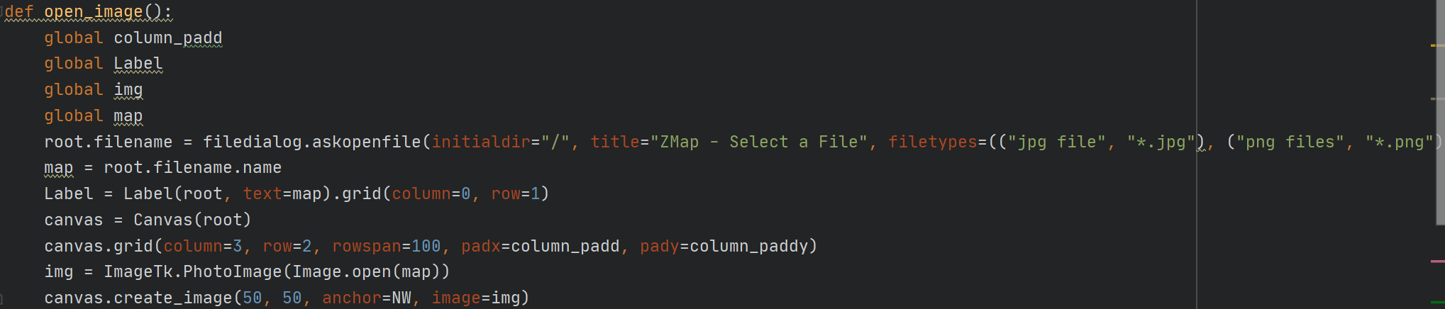
Record evidence that you have trialled multiple components and have selected those most suitable.
2
My next version of the file upload window was more advanced and had a dropdown menu and the ability to open a file dialogue window and a function to close the window when the ‘submit’ button was clicked.

Slide 15
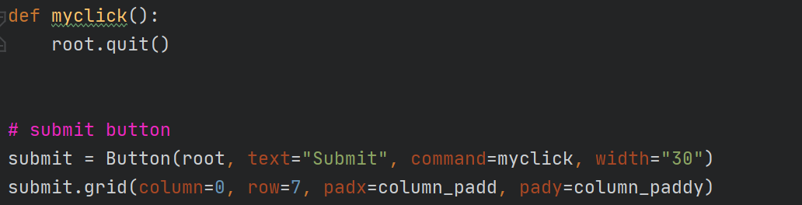
Record evidence that you have trialled multiple components and have selected those most suitable.
3
My next version of the file upload window was a fixed version of my previous code as the function that closed the window was not getting called so I fixed it and applied it in the next version.

Slide 16
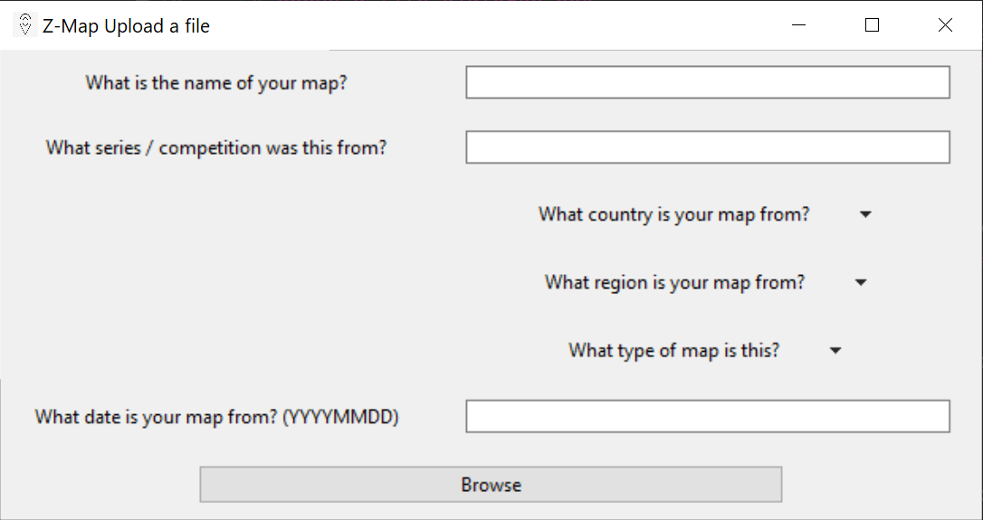
Record evidence that you have trialled multiple components and have selected those most suitable.
4
My next version of the file upload window was more complex and had more entry widget and dropdown widgets as well as labels. I also introduced a icon for my Tkinter Window

Slide 17
Record evidence that you have trialled multiple components and have selected those most suitable.
I ended up using version 4 because it was easy to use, had information that was easy to upload and enough information for the use of this product

Slide 18
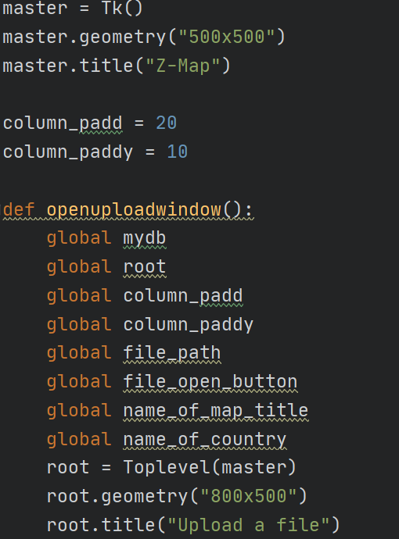
Decomposing
After this was finished I next learnt how to have multiple windows within my program.
This was tested in a basic version of my upload window code which showed a home page and when a button was pressed, displayed the upload window page.
This was done by putting the upload window code in a function and opening the widgets in a new window created by the widget ‘Toplevel’

Slide 19

Decomposing
After this I then made this new button link to the updated upload window with more input widgets. As shown in the upload file function in version 2.1.1
Continuing on from this I started learning about how databases and python can interact.
After some research I decided to use SQLite3 as it was a lot simpler than MySQL and also integrated to python very well.

Slide 20
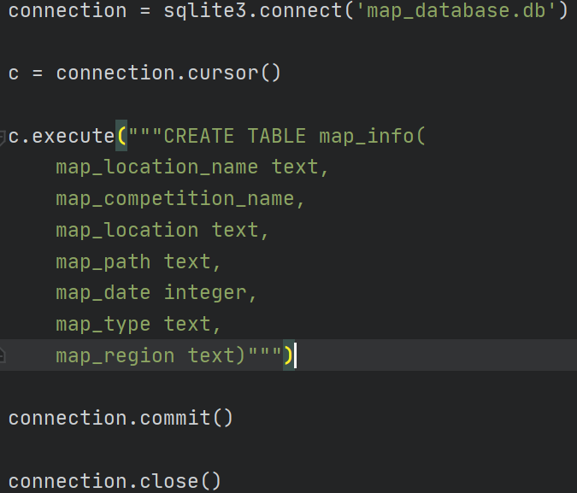
Decomposing
The first step for using the database was creating it. I followed a free tutorial from codemy.com on youtube to learn how to create this database and created the different fields and types of data that I wanted to store.
The first line connects to the database and if not existent will create it. The next line creates a ‘cursor’ to do activities within the database. The next lines create a table within the database to store data with labels and type of data store. The next to lines commit the changes and close the connection

Slide 21
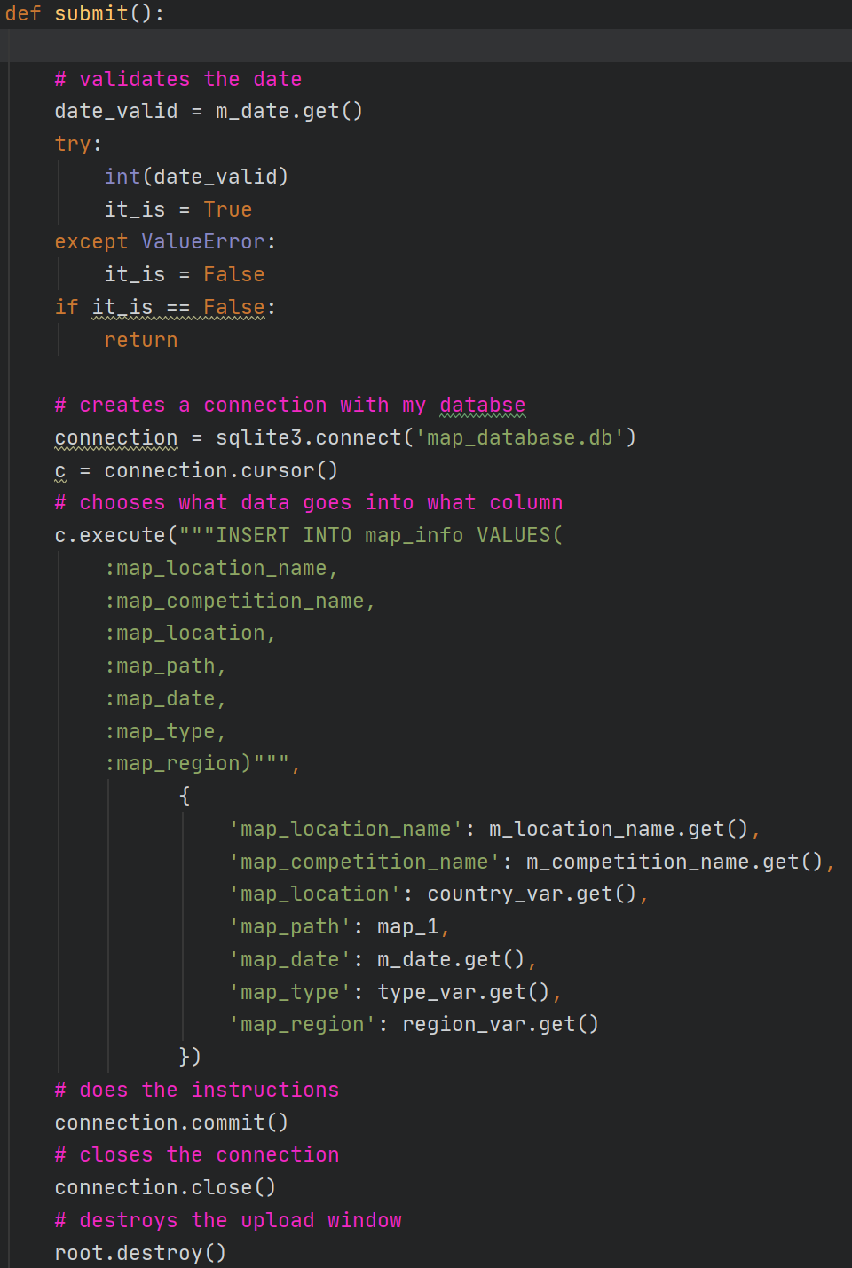
Decomposition
The next step was to create a submit button that collects data from the input fields and uploads it to the selected table in my database.
This function firstly checks if the input in the date fields is a valid answer by using the try + except function.
Next it connects to the database and inserts the value from the selected fields into the given columns in the table.
I then closes the connection and destroys the upload window.

Slide 22
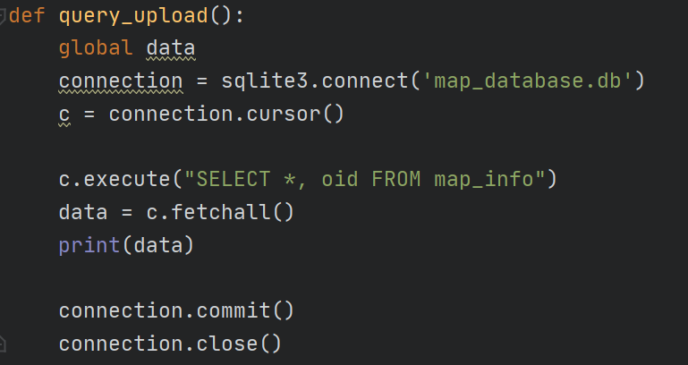
Decomposition
I next created a query function to check if the information I had uploaded had been properly executed and uploaded, this function would later be removed in the final version.
This function selected all data in the table and displayed it in the python window allowing me to see if my data had been updated.

Slide 23
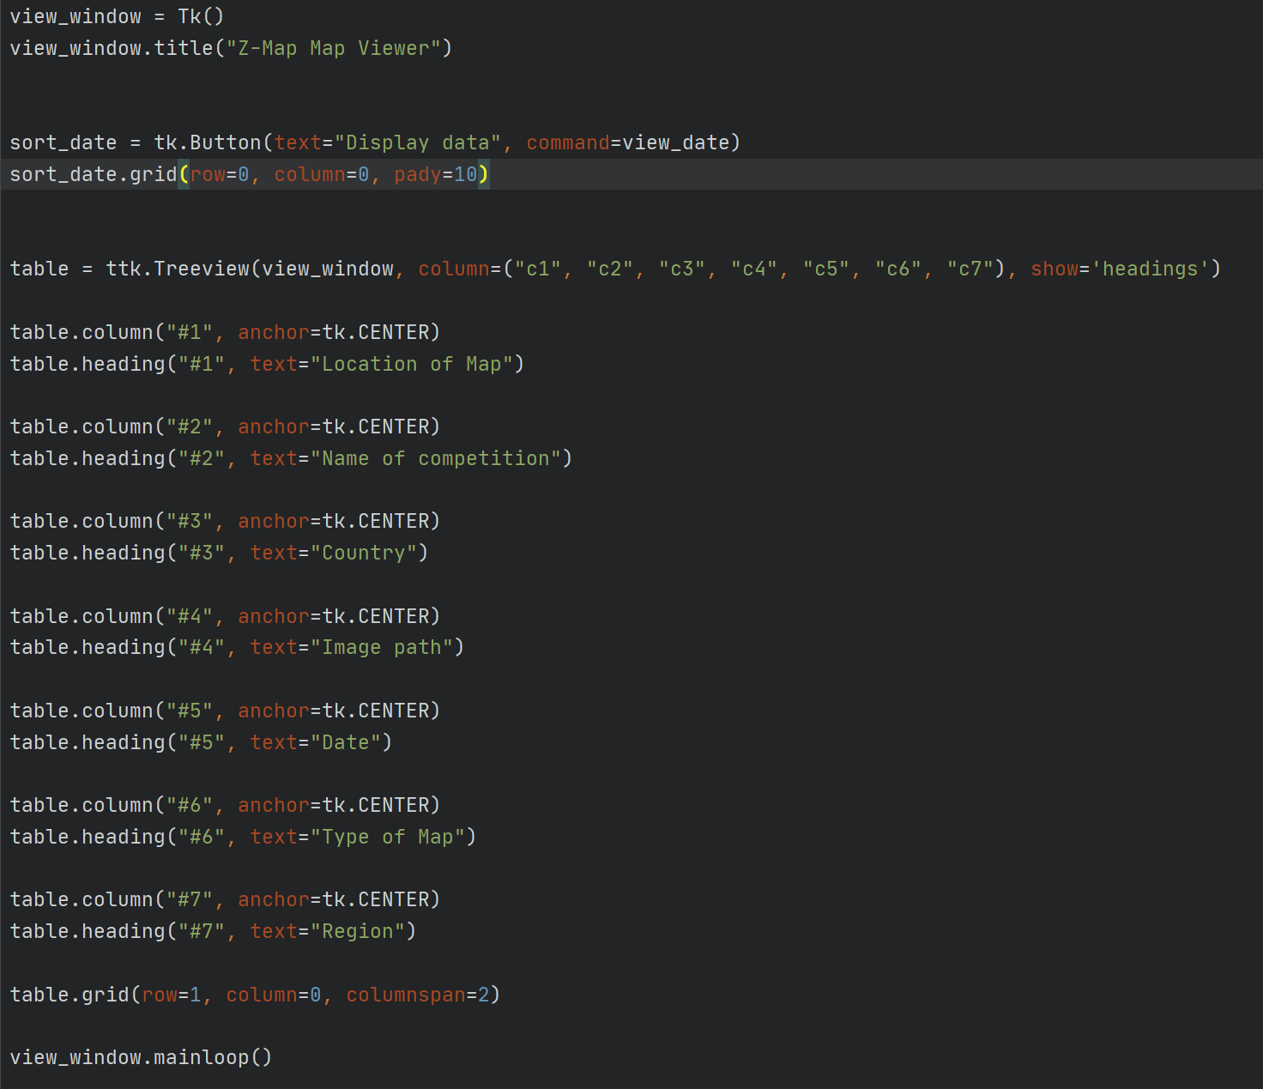
Decomposition + Trialling
I next created a function to create a new window and display a table with all the current data.
To do this I could have used treeview or a multitude of text widgets with borders.
I chose to do it with treeview as this meant it was a lot easier to provide information and style what the table looked like.
I first had to set up the basics of the table such as headings and columns.

Slide 24
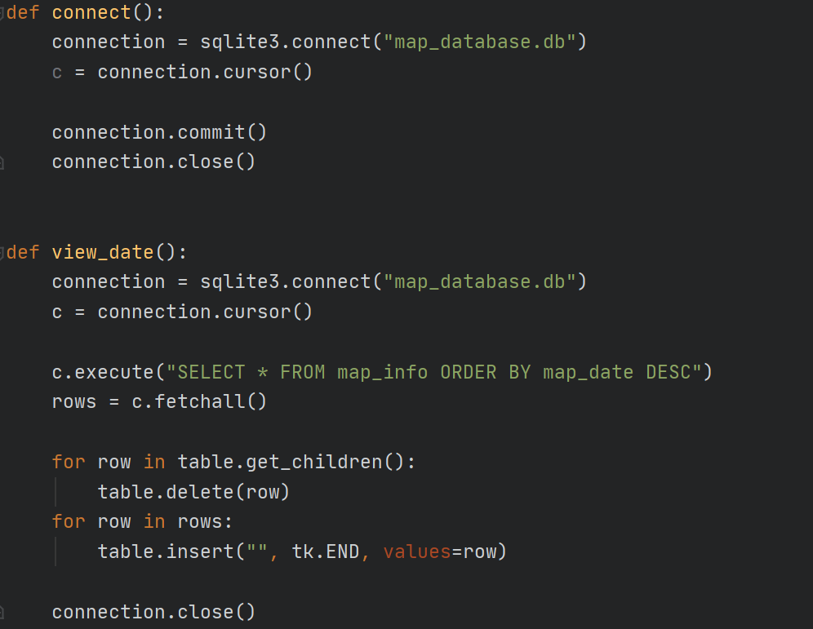
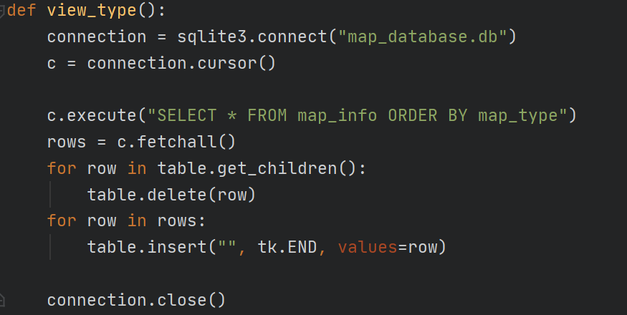
Decomposition
I next used a for loop to display all the data that was stored in my database table into my python table.
After this I created buttons to sort the maps by type of map.

Slide 25
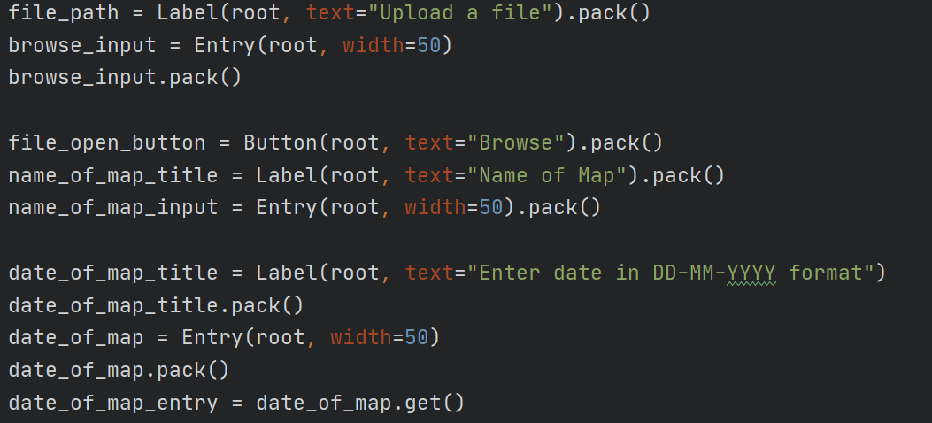
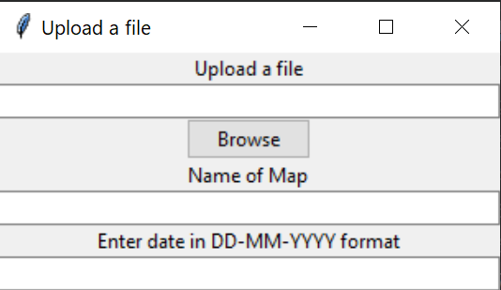
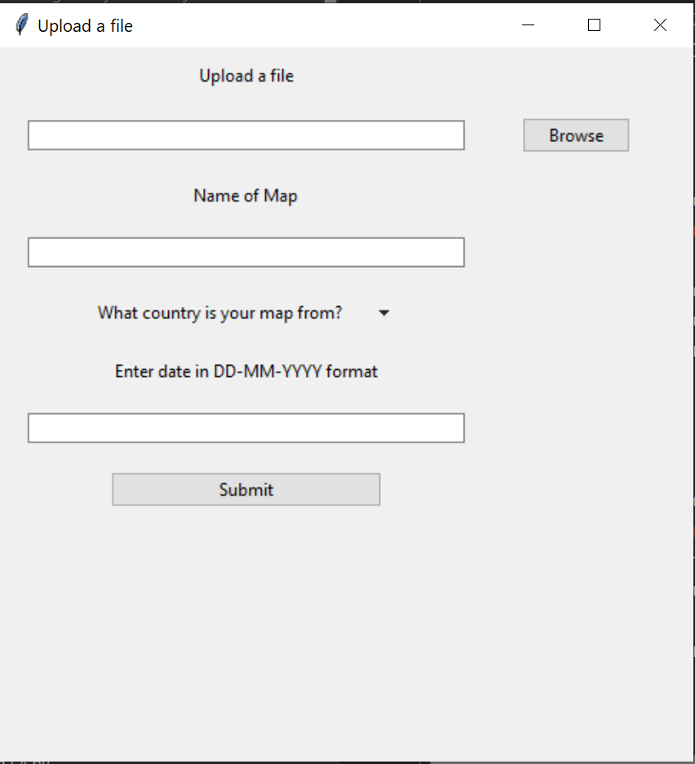
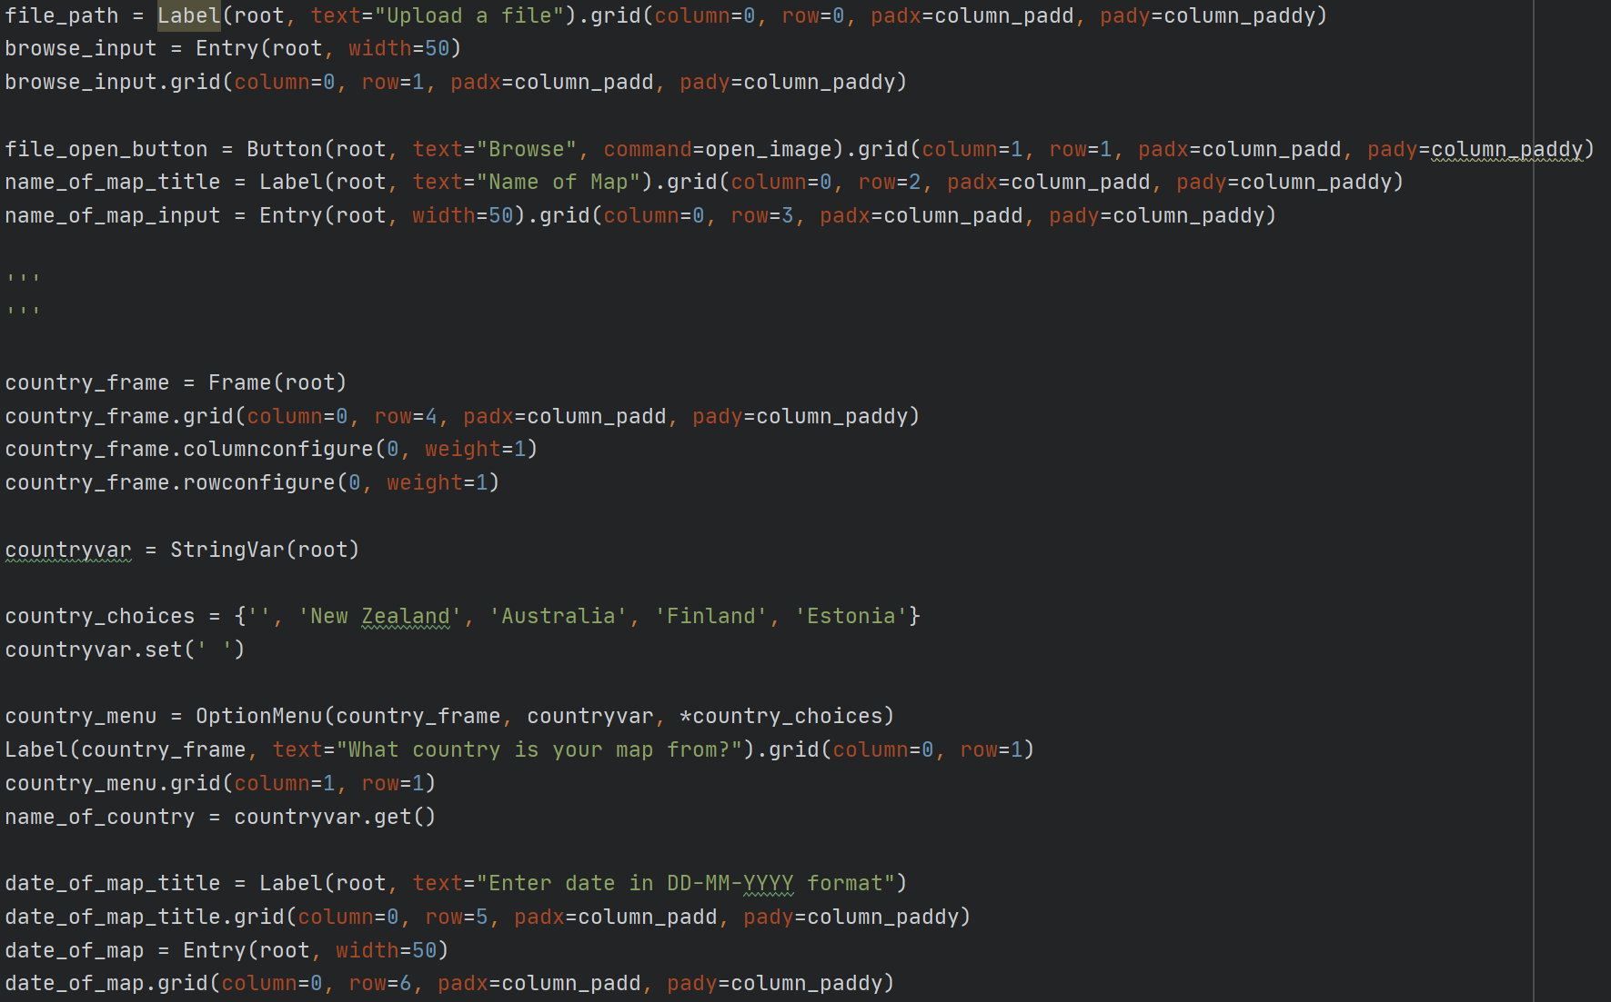
Testing Outcome - Debugging
One of my first errors in my code was having code that was not being displayed on the window or not being in the right spot and looking jumbled.
I fixed this by using the grid widget instead of the pack widget.
This allowed me to place widgets on my window more accurately and using padding to space the windows apart and make it easier to view.
Top: Shows using pack widget and outcome
Bottom: Shows using grid and padding and outcome of that

Slide 26
Testing Outcome - Debugging
Before
Another error that I encountered was when I created a button, the command would not call the function.
To debug this I first tested the commands inside the function to determine there was not an error there.
I then tested syntax using PEP8, there was not an error.
I next consulted other students and online forums such as stack overflow, this helped me realise that the command within the button did not need a bracket after the name.
After

Slide 27
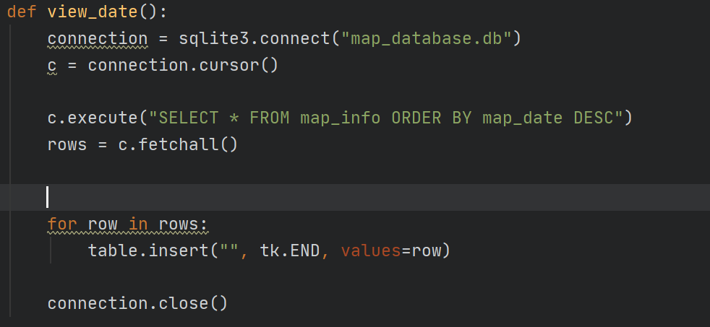
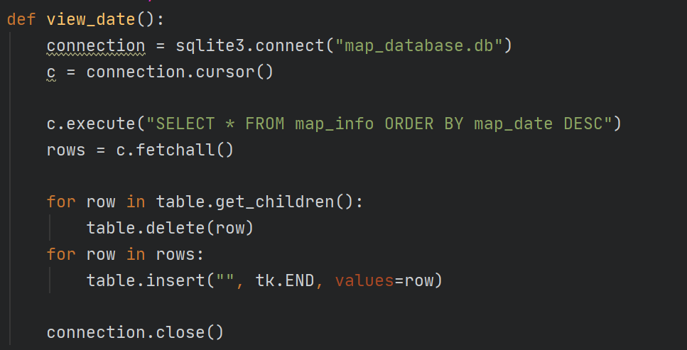
Testing Outcome - Debugging
One error that I had was that when I called my function it presented the results in the table on top of the previous results instead of deleting them first.
To fix this problem I researched and used stack overflow to learn more about the treeview widget and how to delete results first.

Slide 28
Testing outcomes Comparing Alternatives
One of the components that I had to trial and compare alternatives was the database software.
In the end I chose to use SQLite3 as it was easy to integrate into python and I did not need to store a very large amount of data and thus SQLite3 would be sufficient
 | Advantages | Disadvantages
Sqlite3 | Easy to incorporate into python File based | Lacks a lot of functionality Not as functional with lots of data
MySQL | Easy to use Lots of functions Can store lots of data | I found it hard to integrate into python when testing Not as reliable

Slide 29
Testing outcomes - Comparing Alternatives
Another decision that I had to make was what GUI library to use. The two options that I had were TKinter and PyQt.
In the end I chose Tkinter as there were lots of tutorials and it seemed easy to use. My code would not require very advanced options and thus Tkinter would be suitable. PyQt had a steep learning curve and thus would not be able to fit in my timeline due to the deadline imposed on us.
 | Advantages | Disadvantages
Tkinter | Simple to understand Comes pre-installed in python Lots of documentation and tutorials | Does not have advanced widgets It looks clunky
PyQt | Lots of flexibility Lots of advanced widgets | Lack of python documentation thus making it hard to implement in my program Steep learning curve and requires lots of time

Slide 30
Testing outcome - Testing tables
I created a very simple date validator which checks if the input is a number, if a letter or special characters. I did not see the need to put a validator for the text input fields as the inputs could consist of anything and thus no necessary.
INPUT | OUTPUT
22032004 | YES
22-03-2004 | NO
twentytwo032004 | NO
My program does not handle entry of dates in other formats such as mm-dd-yy or mm/dd/yyyy, to help with this I have stated what format the date must be entered, however I know that in future iterations my program will have more capacity to handle inputs but I had to prioritise my tasks as our time was coming to an end and I still needed to fix the table widget.

Slide 31
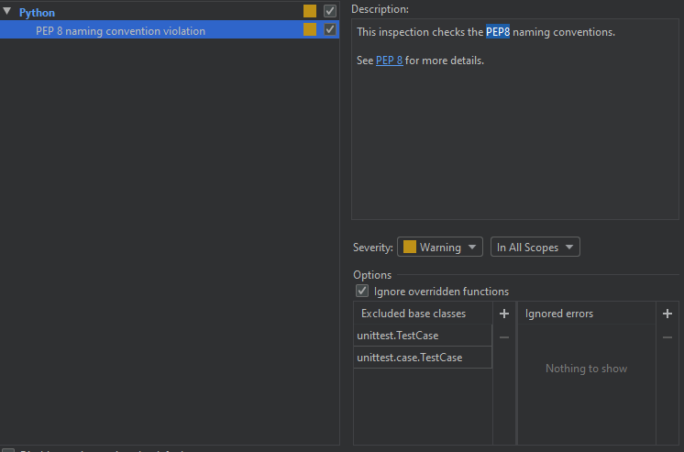
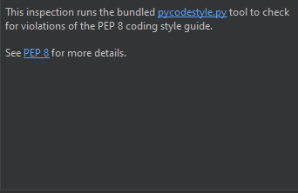
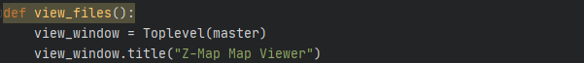
Testing Outcome - Code validation
To validate my code I used the inbuilt PEP8 checker in pycharm. PEP8 is a validator built for python to check coding style guide and naming conventions. The inbuilt PyCharm version checks for the conventions and if there is a failure then it highlights the line in yellow.
Top: Screenshot showing how PEP8 validator was set up in settings
Middle: Screenshot showing other PEP* coding style checker I had set up
Bottom: Screenshot showing what PEP8 failure looks like

Slide 32
Testing Outcome - Usability testing
To test the usability of my outcome I got my friends, Finn and Alex to test it. They found it very easy to use as the buttons had labels on them and there were no opportunities to put in wrong information or cause an error.

Slide 33

Testing Outcome - FINAL testing

Slide 34
Usability - Description
The usability of an outcome is how easy and effective it is to use a product. This can be broken down into how easy it is to use a product, how safe it is to use and how effective and efficient it is to use a product.
In my product I have considered the usability to improve how my client interacts with my product. I have made sure that my program is intuitive to use and they cannot crash the program.
On my home page there is only 3 buttons with clear labels and thus no error can be caused
On my upload page there are text fields which can have any input, except for dates which must be a number. There is also a dropdown menu which provides all the possible input and thus a false input cannot be entered.

Slide 35
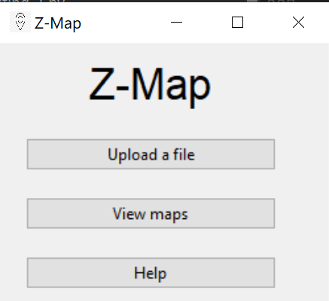
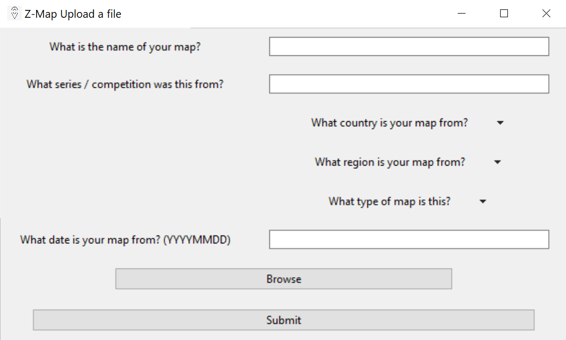
Usability - Proof
This shows hows the buttons are clear and the contrast between black and white of the text makes it easy to read
The 2nd screenshot shows how it is easy to understand what to input and how to submit it.
To improve my usability of my outcome I have made my program run faster by using functions to reduce the amount of code by not repeating. This allows the code to be quick and efficient. Video below shows the speed of the outcome.

Slide 36
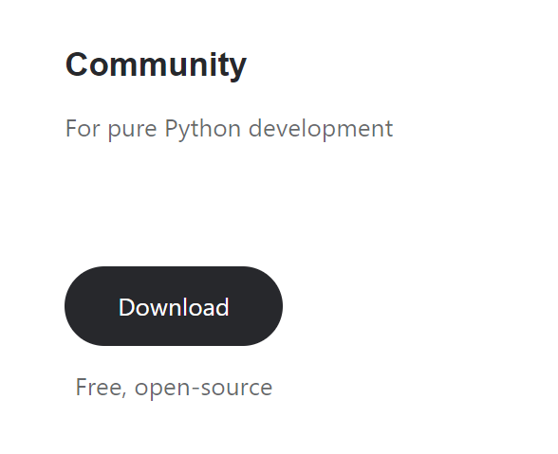
Legal
Legal was a relevant implication in the fact that I had to use open source, free code development platforms.I chose to use PyCharm Community Edition 2020.1.1 which is a free to use software developed by jetbrains.
Right - Screenshot of pycharm website showing community version is free - https://www.jetbrains.com/pycharm/download/#section=windows

Slide 37
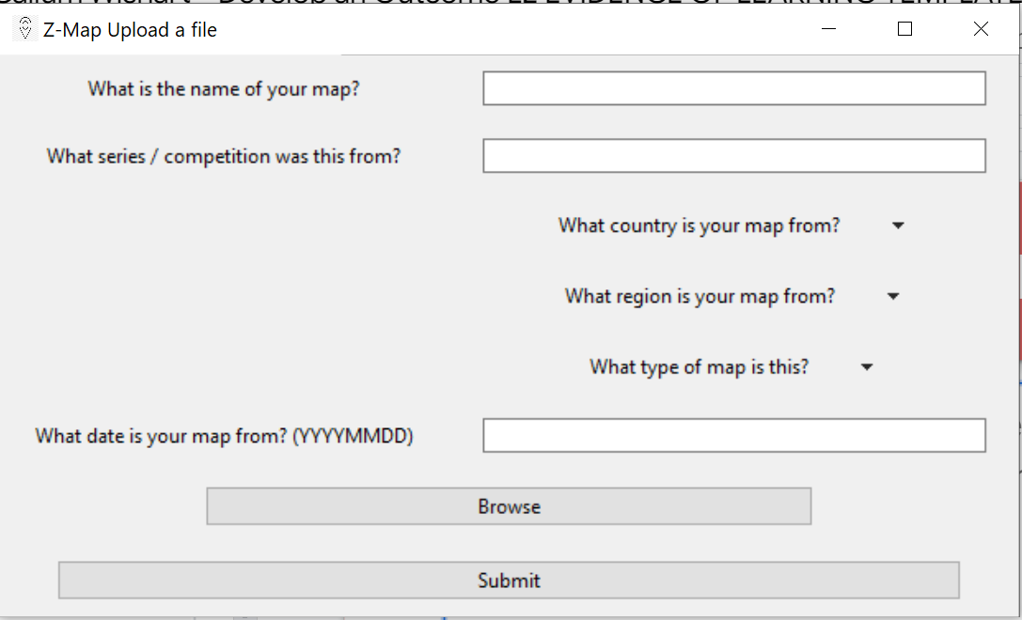
Privacy - Description
Privacy is how information is collected, stored and what is done with it. In my program I collect no information about the user. The only information I collect is data about the map being processed 1. My program does also not publish this information anywhere and stores it in a private database stored on their computer. My program does not collect any information without the users knowledge.
1.

Slide 38
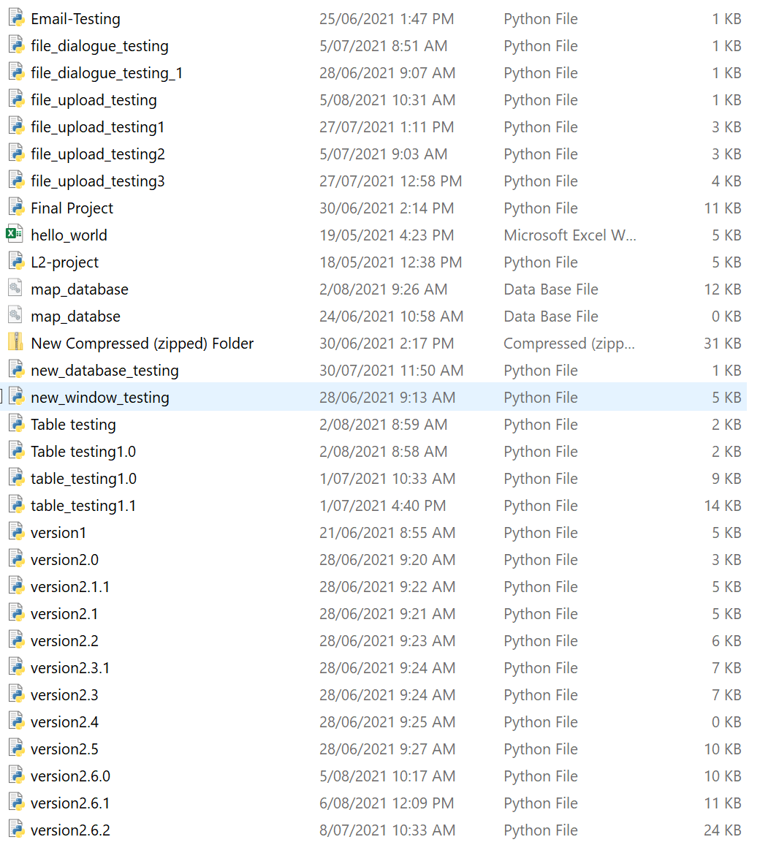
Intellectual Property 1.0
Intellectual property is a type of property that was created by humans, it can be inventions, code, images or other such resources. Addressing this in my program meant that I had to not use other people’s without their permission, not use images that I did not have the right to and use software for developing that I had permission to use.
In my outcome I have not used any images in the actual development however users have the ability to upload their own images, I do not use the images in other outcomes so this is ok.
Right- No images stored in my project folder

Slide 39
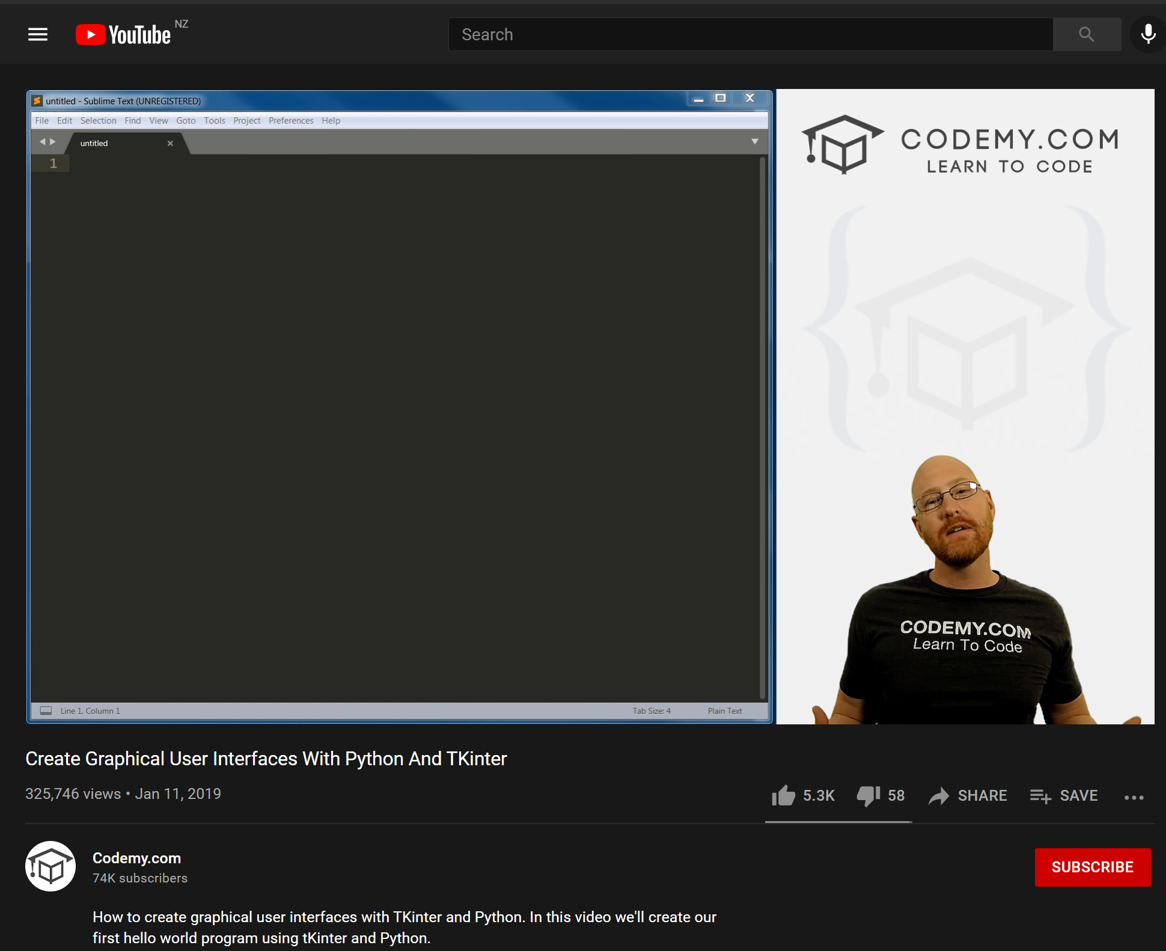
Intellectual Property 1.1
The next time I had to address intellectual property was when I was developing my code. I used many free to use tutorials on youtube posted by codemy.com. I also did not copy his code and used his code to teach me how to write my own.
Right - Screenshot of codemy.com youtube channel

Slide 40
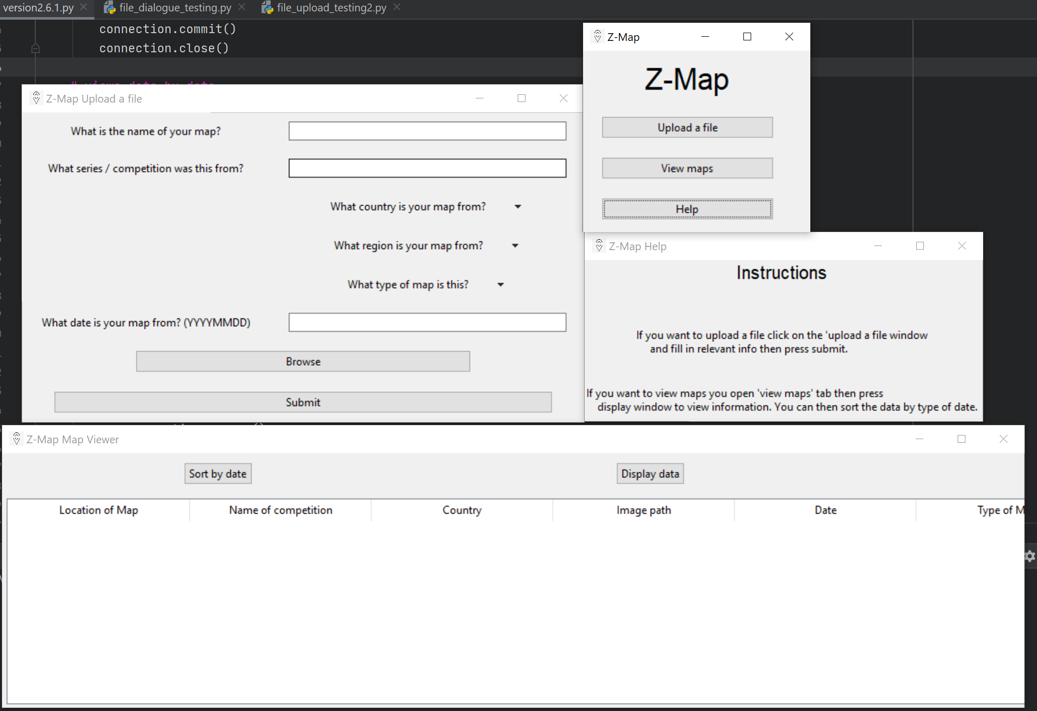
Accessibility 1.0
The accessibility of product is how accessible a product is, and how people with disabilities may be able to use the product.
I have made my program accessible to people with colour blindness by using high contrast colours as shown in 1. I also tested this by using a colour blindness simulator (https://www.color-blindness.com/coblis-color-blindness-simulator/) and tested Anomalous Trichromacy, Dichromatic view and Monochromatic view. In all versions of these colour blindness simulations the text was readable easily.
1.

Slide 41
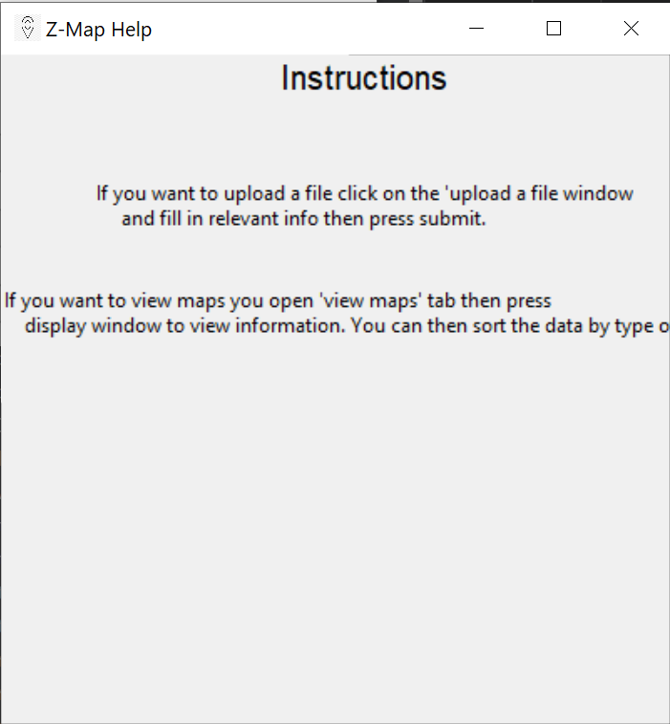
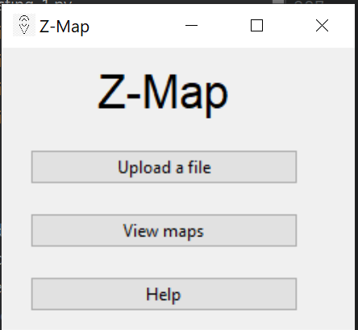
Accessibility 1.1
Another aspect of accessibility I tested was how people with learning disabilities may interact with program. To consider this I created a simple instructions page 1. as a well as making the program simplistic with simple buttons and text fields so that the user may easily access what they want to do within the program.
Unfortunately I did not have the opportunity to make the program be able to be controlled by the keyboard so that people with limited fine motor control could use it, however to help with this I made the buttons and text fields large and easy to click 2.
I did not make this program accessible to blind people by having audio transcripts as I felt that blind people would not be using this program as it is based off of images, and it’s primary use is organising images
1.
2.

Slide 42
Reflection on testing and trialling
The testing and trialling that I did throughout this time helped me achieve a high quality outcome that met the stakeholders needs.
With the use of trialling multiple components I was able to decide which one best suited my product by measuring the pro’s and con’s of each solution. This combined to give me a high quality outcome. The testing that I completed helped me to discover errors, bugs and streamline the user’s experience of my outcome. This helped to create a product which was easy to use, had high efficiency, no errors and suited the stakeholders needs.

Slide 43
Evaluate
All these processes worked together to help me create a functional program which satisfied by design brief of the outcome. These processes helped me to manage my time, improve my product and design it to the best of my ability.
To improve my outcome I would have understood that project management was far more important than I previously thought as I did not think that I used all the time I was given to the best of my ability. I would also improve the viewing function of my program as it is only very basic currently and I want to install new features such as append, delete and make it more visually appealing. Another aspect I would continue to develop would be the home and instructions page as they were last minute. To make it more user friendly I would improve the error handling done by the program and check if more inputs were valid and also a way of telling the user why their input was wrong.
Overall I think I produced a good product with the time I was given however there are still lots of aspects which can be improved upon in further updates.

